Slide 1

Project: Auto Odo
By: Team 4
Thomas Springston, Kingsley Tran, Patricia Ong

Slide 2

What is Auto Odo?
Auto Odo is a mobile application that aims to allow the user to easily be informed of the total amount of distance they have traveled for work during a particular day, week, or month. The distance will be given in miles.
The purpose of this application is to make it easier for users to track their work miles through a click of a button and provide them the necessary information they need, which they can use to increase their tax savings, as work miles are tax-deductible.
Note: In addition, though uncertain as of now, the application may integrate google maps in order to specifically show the user the routes they have traveled that the app has tracked.

Slide 3



Tools
The IDE that we will be utilizing is Android Studio.
Our programming language of choice is Java.
As for the database, we will be using SQLite.

Slide 4
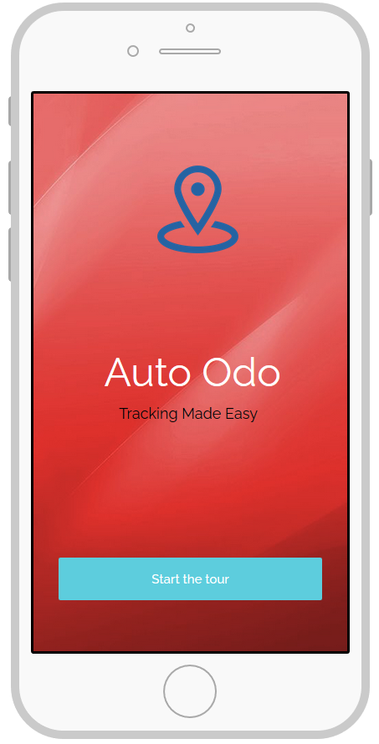
Early Mockup Ideas

Slide 5
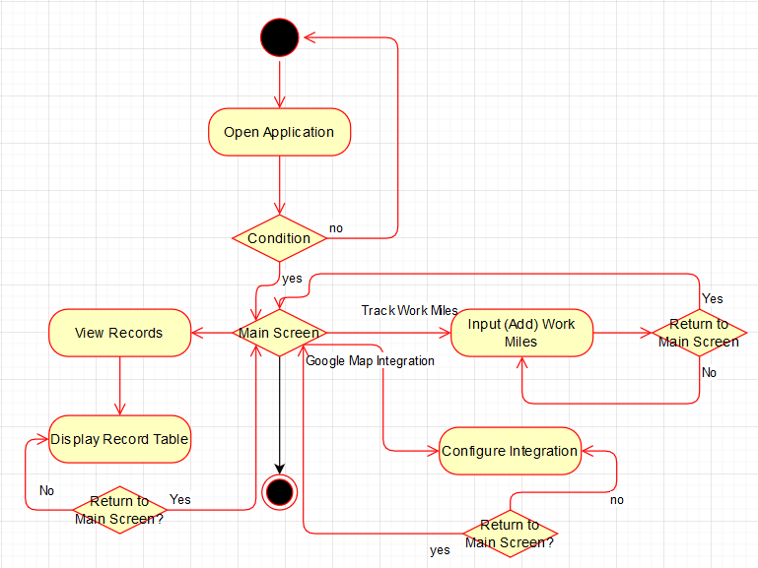
Activity Diagram

Slide 6
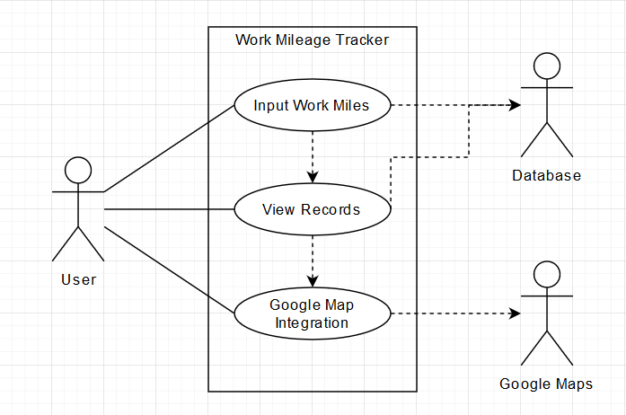
Use Case Diagram

Slide 7
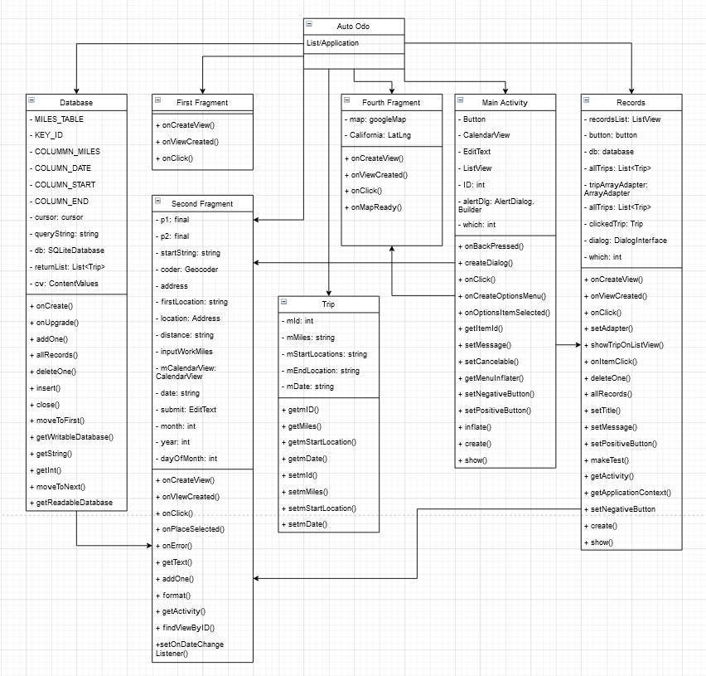
CRC Diagram

Slide 8
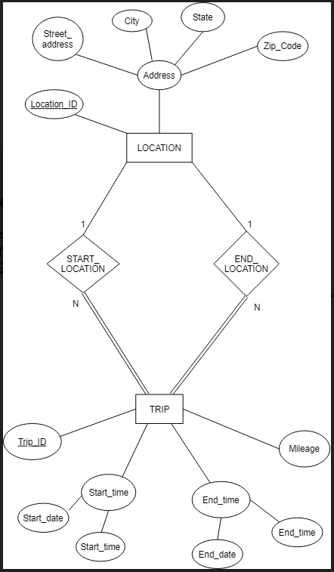
ER Diagram

Slide 9
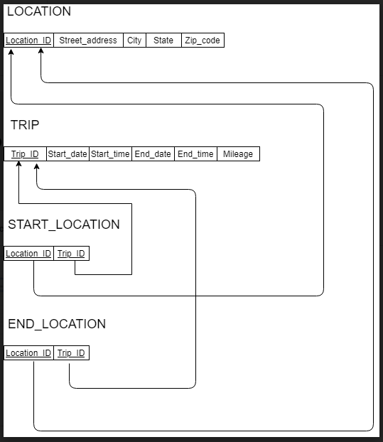
Relational Model

Slide 10
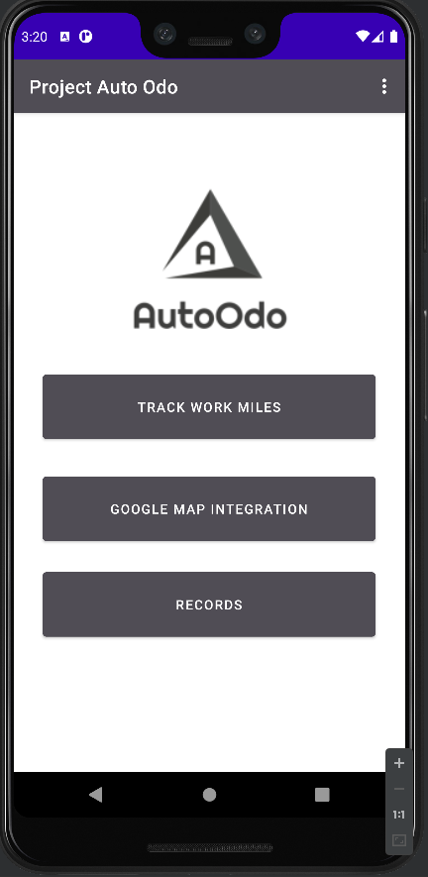
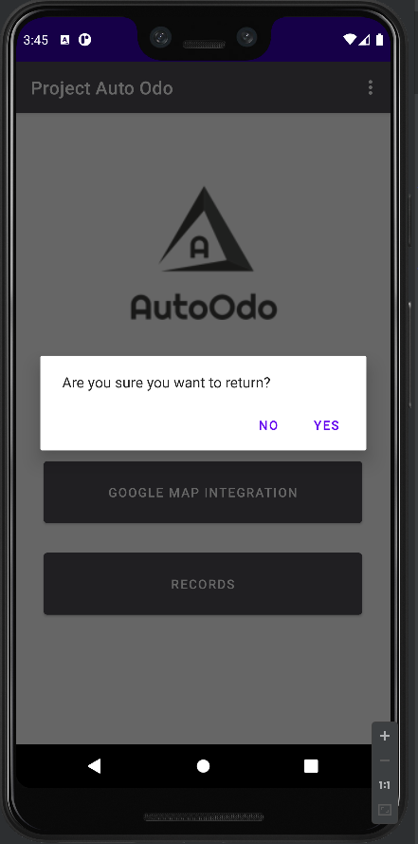
Main Screen & Return Button

Slide 11
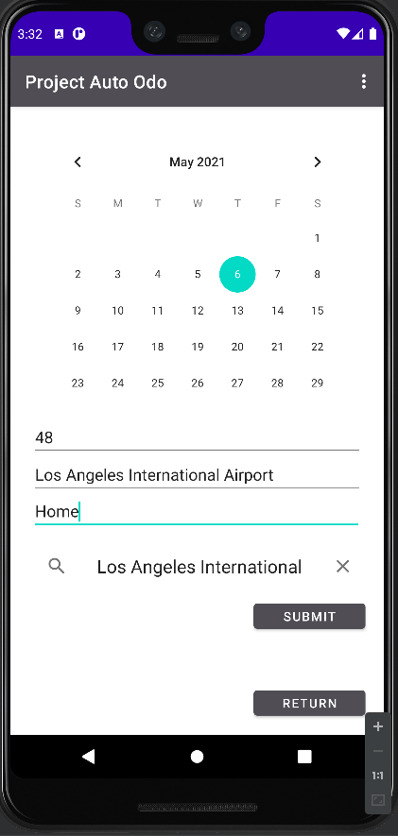
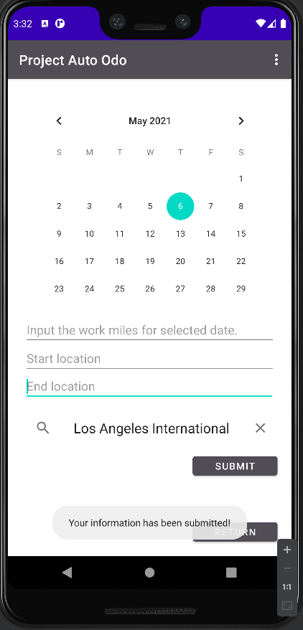
Inputting items into the database.

Slide 12
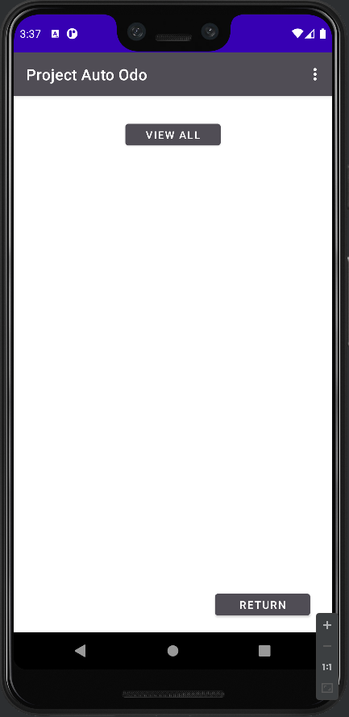
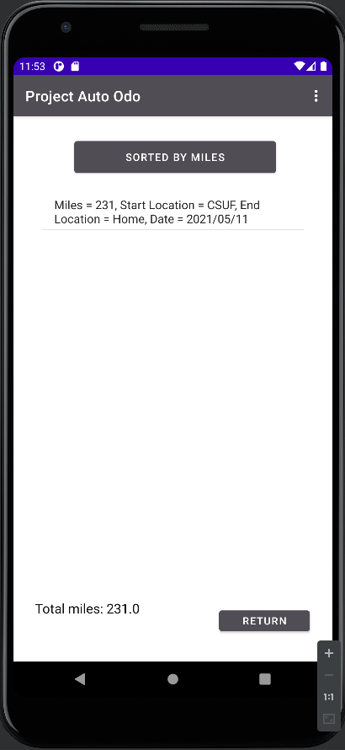
Checking the record on the database

Slide 13
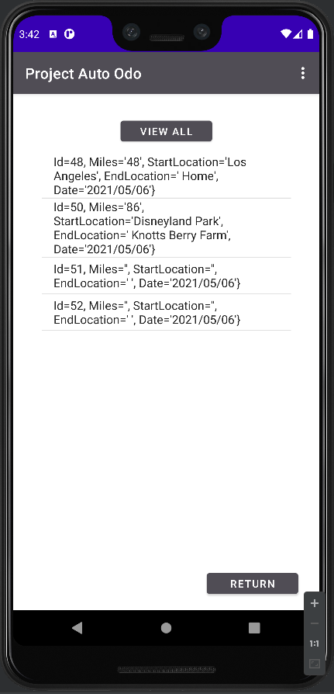
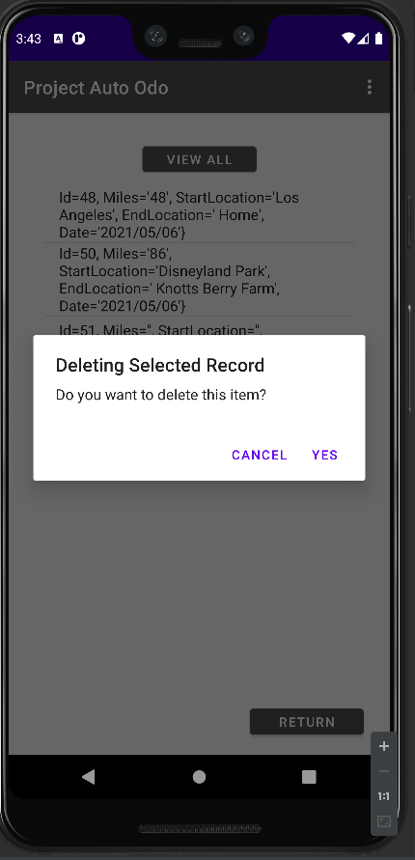
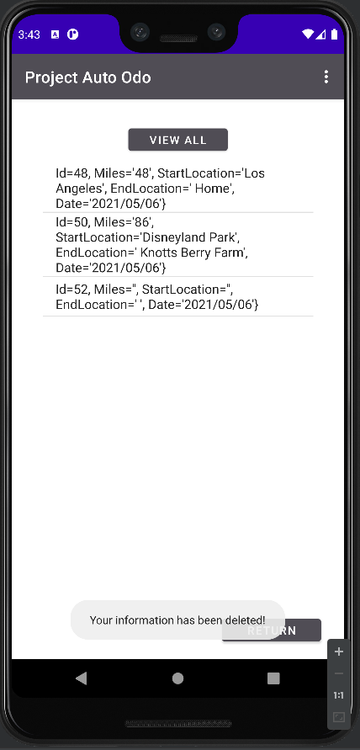
Deleting a record

